Slide 1
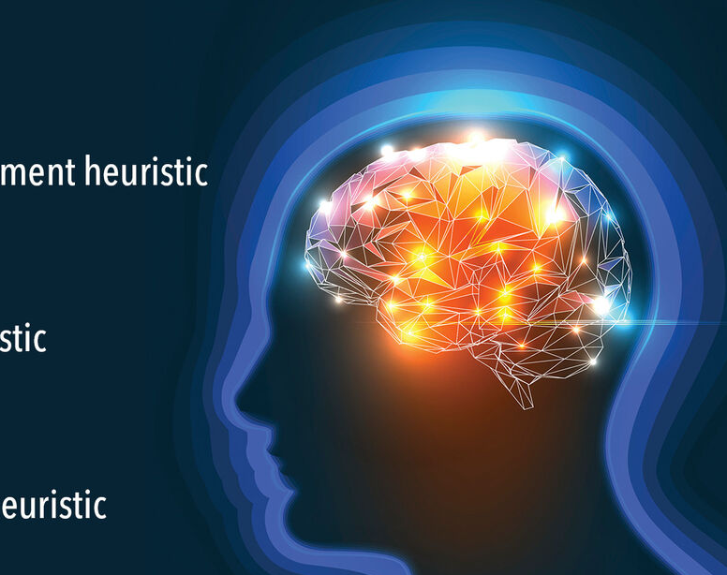
Heuristic Search 3
Genetic Algorithms
Week 10

Slide 2
Contents
Genetic Algorithm
Other Methods
  Simulated Annealing
  Ant Colony Optimisation
  Particle Swarm Optimisation

Slide 3
Genes and Chromosomes
Genes are segments of deoxyribonucleic acid (DNA) that contain the code for a specific protein that functions in one or more types of cells in the body or the code for functional ribonucleic acid (RNA) molecules.
Chromosomes are structures within cells that contain a person's genes.
A trait is any gene-determined characteristic and is often determined by more than one gene.
Some traits are caused by mutated genes that are inherited or that are the result of a new gene mutation.

Slide 4
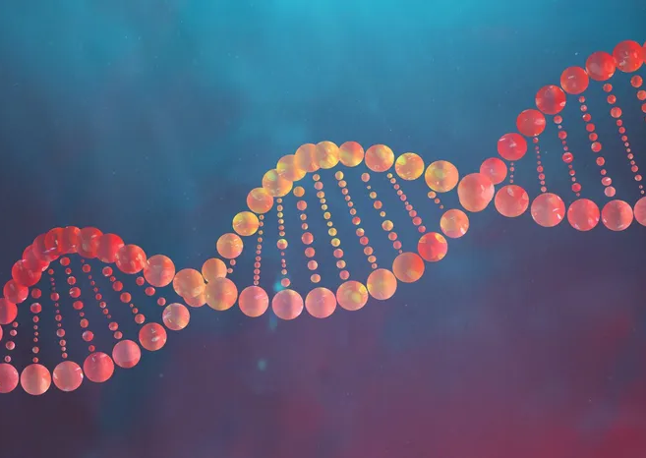
Genetic Algorithm
Genetic Algorithms “mimic” evolution.
Evolution is the change of a gene pool over time.
A gene is a biological hereditary unit that is passed on (usually unaltered) for many generations.
Genes are contained within the nucleus of a cell, within Chromosomes.
Most organisms have multiple chromosomes.

Slide 5
Genetic Algorithm
Genes mutate through random change
Individuals are selected/survive, through Natural Selection
Populations evolve and breed through recombination
The technique uses biological metaphors
  Each gene is a binary digit
  A chromosome is a single string of genes (Haploid)
A solution to a problem is encoded as a Chromosome
  The encoding is called the representation
  It must cover the whole search space
A Fitness Function is needed to rate how good a solution a chromosome represents

Slide 6
Population and Generations
An organism is a chromosome
The population is the number of chromosomes “alive” at any one time
The term generations is the number of times breeding has occurred

Slide 7
Crossover and Mutation
Two concepts are defined, which are referred to as Genetic Operators
Crossover
  This is analogous to recombination or breeding
  Typically, genetic material from two parents are combined to create children
Mutation
  This is analogous to biological mutation
  Genes are randomly changed

Slide 8
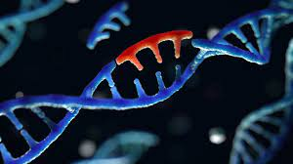
Mutation
Each bit (gene) of a chromosome is given a chance (probability) MP of inverting
  A ‘1’ becomes a ‘0’
  A ‘0’ becomes a ‘1’
01101101
00101111
(These ones)

Slide 9
Crossover
Crossover is a process to exchange the genes from parents to produce 2 children (potential solutions)
Parents (A and B) are the best solutions in the population used to produce children
Children (C and D) get some of the genes from A and B
Crossover techniques can be one point or uniform

Slide 10
Crossover - Example
Parent 1
Parent 2
P1
P1
P1
P1
P1
P1
P1
P1
P1
P1
P2
P2
P2
P2
P2
P2
P2
P2
P2
P2
One Point
Uniform
Child 1
P1
P1
P1
P1
P1
P1
P2
P2
P2
P2
P2
P2
P1
P2
P1
P1
P1
P1
P2
P1
P2
P2
P2
P2
P2
P2
P1
P1
P1
P1
P1
P1
P2
P1
P2
P2
P2
P2
P1
P2

Slide 11
Crossover Probability
The crossover probability is a parameter that controls the likelihood that crossover will occur between two parent solutions.
If we set the crossover probability to a high value, it’s more likely that crossover will occur between a pair of parents.
The values should be between 0 and 1.

Slide 12
Crossover Probability – Example
(One Point)
Parent 1
Parent 2
P1
P1
P1
P1
P1
P1
P1
P1
P1
P1
P2
P2
P2
P2
P2
P2
P2
P2
P2
P2
0 1 2 3
Crossover probability = 0.3
Length of chromosome = 10
Crossover point = 0.3 x 10
= 3
P1
P1
P1
P1
P1
P1
P1
P1
P1
P1
P2
P2
P2
P2
P2
P2
P2
P2
P2
P2
Produce 2 children from this crossover process

Slide 13
What about Crossover Probability for Uniform?

Slide 14
Mutation Probability
Mutation probability is a parameter in a genetic algorithm that determines the likelihood that an individual will undergo the mutation process.
We utilise this technique to maintain genetic diversity from one generation of the population to another.
We use it to prevent the genetic algorithm from getting stuck in a local optimum or convergence on a suboptimal solution.
A higher value of mutation probability encourages the exploration of the search space.
The values should be between 0 and 1.

Slide 15
Mutation Probability – Example
The best candidate in the population
Randomly change 6 genes in this chromosome
0
1
1
1
0
0
0
0
0
1
0
1
1
1
0
0
0
0
0
1
x
x
x
x
x
x
Mutation probability = 0.6
Length of chromosome = 10
Number of gene = 0.6 x 10
= 6
New chromosome after mutation with mutation pr. = 0.6
0
0
0
0
0
1
0
0
1
0

Slide 16
GAs - Parameters
NG Number of Generations
PS Population Size
CP Crossover Probability
MP Mutation Probability
n The number of bits (genes) making up each Chromosome

Slide 17
GA Pseudocode
Algorithm 1: Genetic Algorithm
Input: | data = the dataset for the problem
1) | Let pop_size = number of individuals in the population
2) | Let pop = generate population for pop_size
3) | Let gen = number of generations
4) | Sort pop in descending order of their fitness (for a maximising problem)
5) | For i=0 to gen-1
6) | Let p1, p2 = top 2 candidates from pop
7) | Let c1, c2 = new candidates from cross over of p1 and p2
8) | Let mutant = a new candidate from mutate of p1
9) | Add c1, c2, and mutant to pop
10) | Sort pop in descending order of their fitness (for a maximising problem)
11) | EndFor
Output: | Solution - the best candidate from pop

Slide 18
GA Pseudocode - Crossover
Algorithm 2: One Point Crossover
Input: | coProb = crossover probability
1) | Let c1 = copy chromosome from parent 1 (Individual)
2) | Let c2 = copy chromosome from parent 2 (Individual)
3) | Let res = an empty list of Individual to store c1 and c2
4) | Let coPoint = coProb x the length of parent’s chromosome
5) | For i=coPoint to length of parent 1’s chromosome - 1
6) | c1[i] = get parent 2’s gene at [i]
7) | Endfor
8) | Update fitness c1
9) | For i=coPoint to length of parent 2’s chromosome - 1
10) | c2[i] = get parent 1’s gene at [i]
11) | Endfor
12) | Update fitness c2
13) | Add c1 and c2 to res
Output: | A list of children (Individual)

Slide 19

Break 5 minutes!

Slide 20
GA Implementation - Individual
public class Individual
{
  public List<int> chromosome;
  public double fitness;
  public List<Double> data = new List<double>();
public Individual(List<Double> dataset)
{
  Random r = new Random();
  data = dataset;
  chromosome = new List<int>();
  for (int i=0; i<dataset.Count; i++)
  {
int gene = r.Next(1,9999)%2;
    chromosome.Add(gene);
  }
  calCurrentFit();
}
Every object of Individual will have the following properties:
A chromosome
A fitness value for the chromosome
We need a dataset for the problem

Slide 21
GA Implementation - Individual
public void calCurrentFit()
public Individual copyIndividual()
public void mutation (double prob)
Methods
An Individual object needs some operations for the experiment to work.
We need these methods to calculate or update the fitness value.
CopyIndividual is needed to support copying genetic from parents.
Mutation is used to produce another individual from the best genetic.
There are more methods we can create for Individual such as, print individual, get fitness, etc.

Slide 22
GA Implementation - Population
public class Population
{
  public List<Individual> pop = new List<Individual>();
  public Population(int n, List<double> data)
  {
    for(int i=0; i<n; i++)
    {
      Individual ind = new Individual(data);
      pop.Add(ind);
  }
  sortPopulation();
}

Slide 23
GA Implementation - Population
public List<Individual> getParents ()
public void addCandidates(Individual c1, Individual c2, Individual mutant)
public void sortPopulation()
public List<Individual> crossOver (double coProb)

Slide 24

Let’s see a demonstration on Genetic Algorithm for Scales Problem

Slide 25

Simulated Annealing

Slide 26
Simulated Annealing (SA)
Simulated Annealing is a stochastic global search optimisation algorithm.
The algorithm is inspired by annealing in metallurgy where metal is heated to a high temperature quickly, then cooled slowly, which increases its strength and makes it easier to work with.
It allows a worse solution to be accepted so that local maximums can be circumnavigated

Slide 27
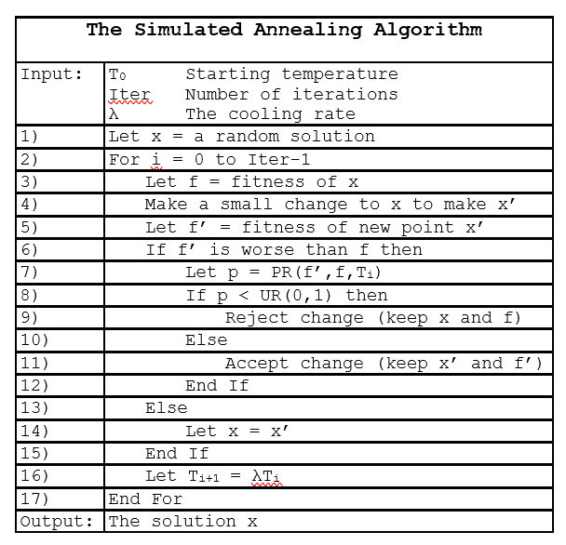

Slide 28
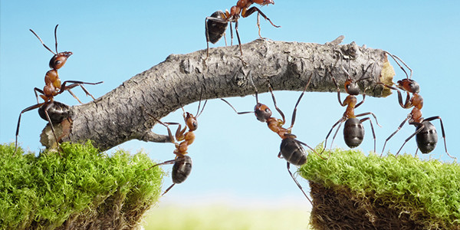

Other Methods
Ant Colony Optimisation
Particle Swarm Optimisation

